Slide 1


Finding an Optimal Layout for the Long Wavelength Array Swarm Station at Meteor Crater
By: William O’Brien
Mentor: Daniel Jacobs

Slide 2
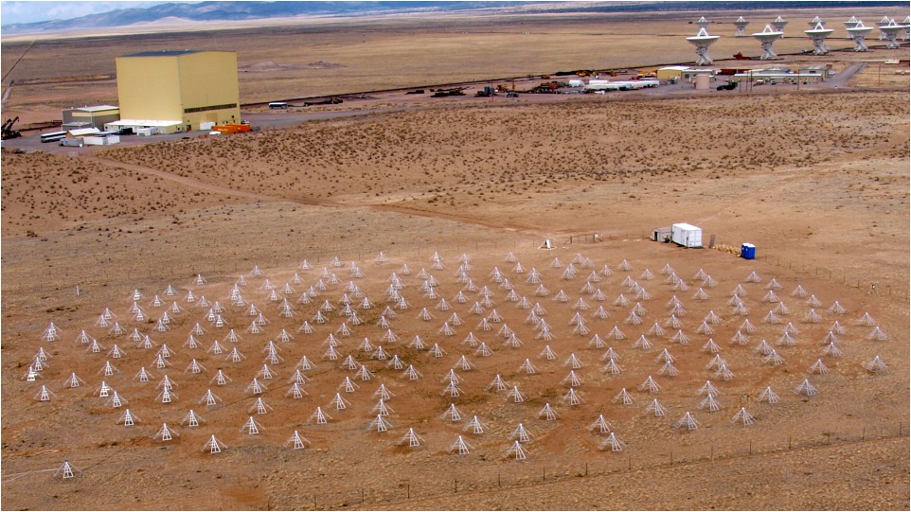
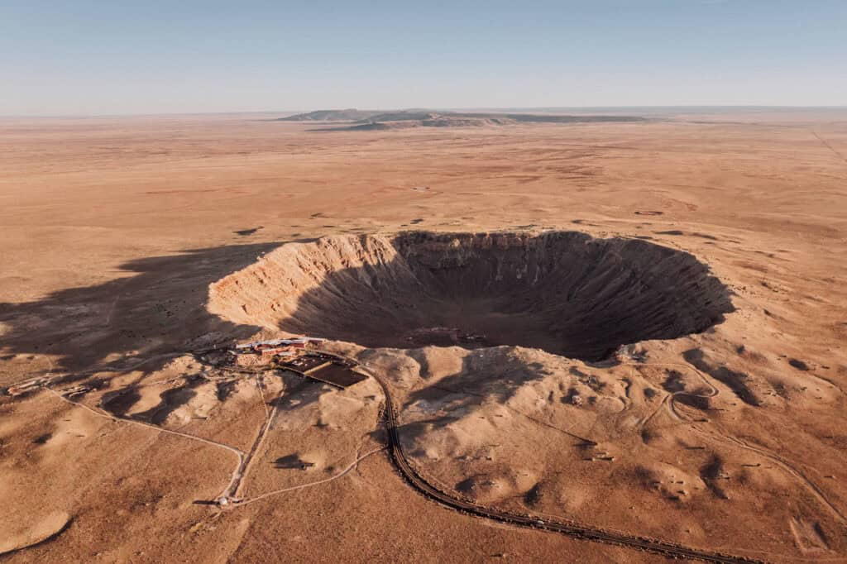
The Main Goal
Long Wavelength Array (LWA) Swarm Station: Using Antennas to make a Telescope.
Meteor Crater: An Optimal Choice of Location
?

Slide 3
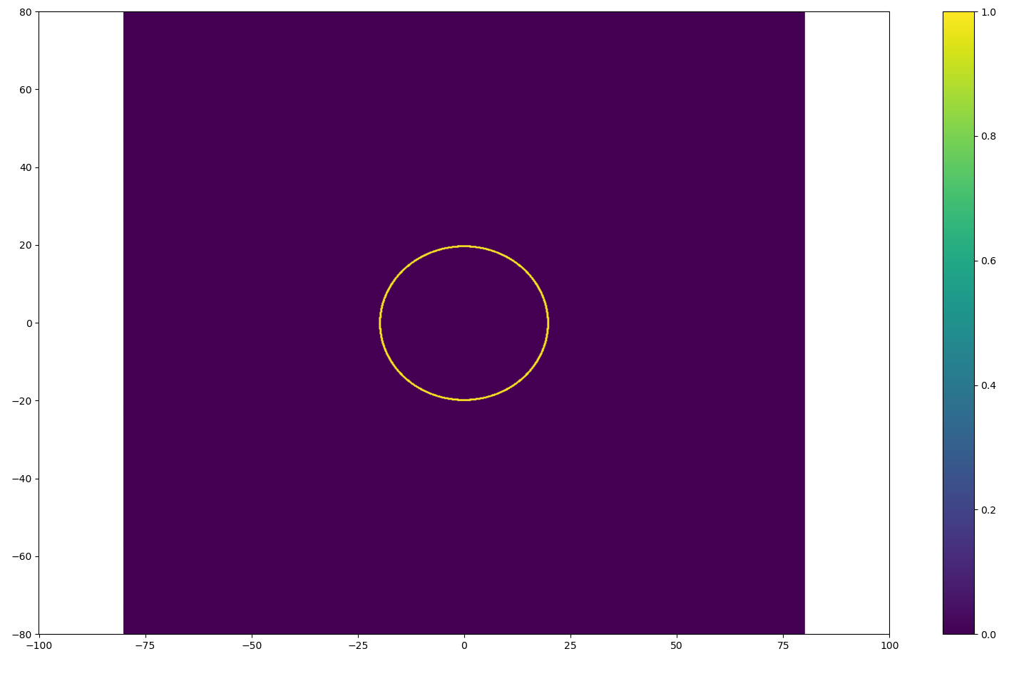
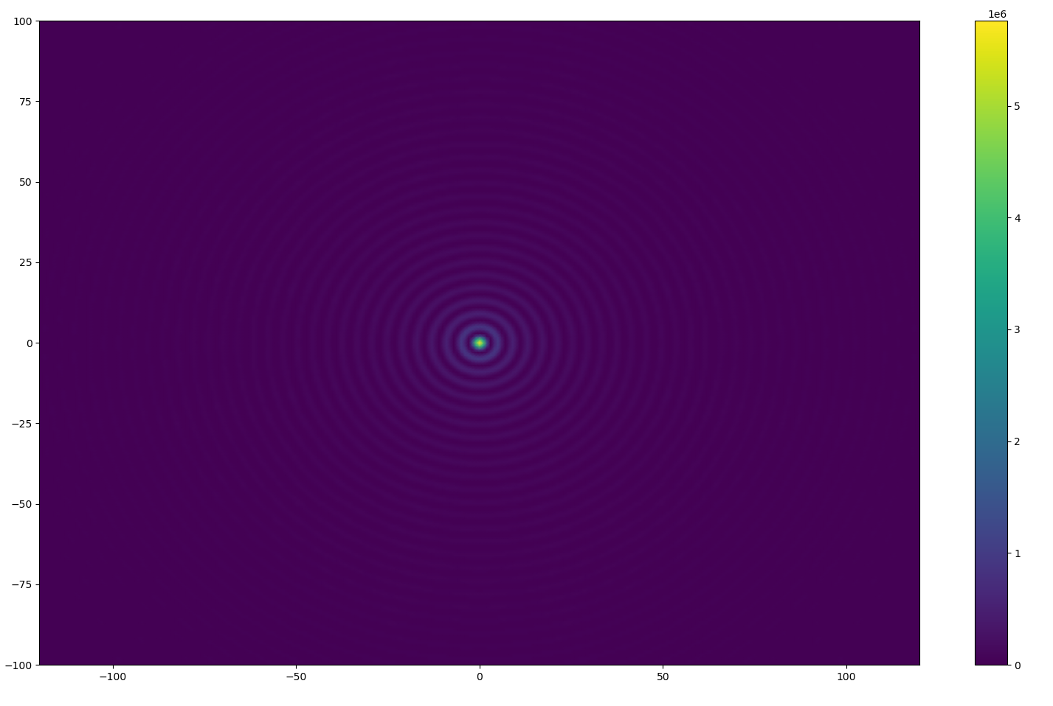
How To Optimize the Resolution Quality
And What To Consider When Proposing a Layout

Slide 4
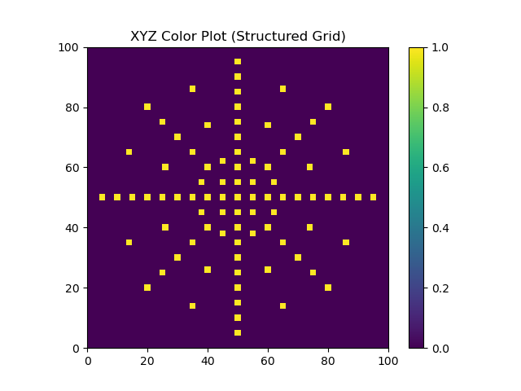
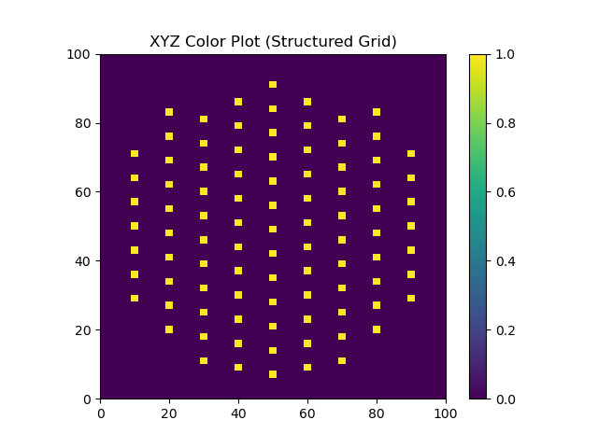
Step 1: Manual Plotting

Slide 5


Step 2: The Fourier Transform

Slide 6
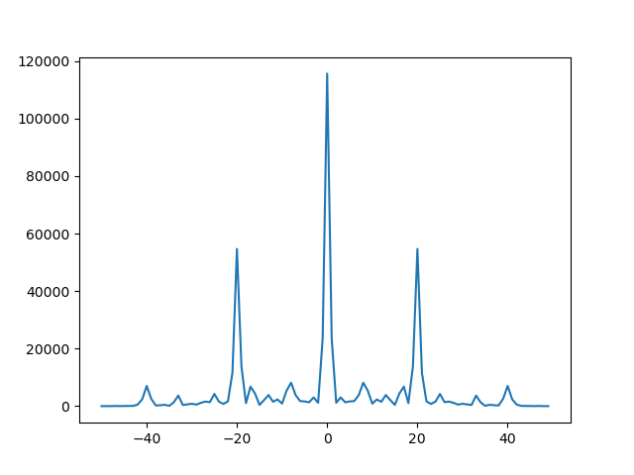
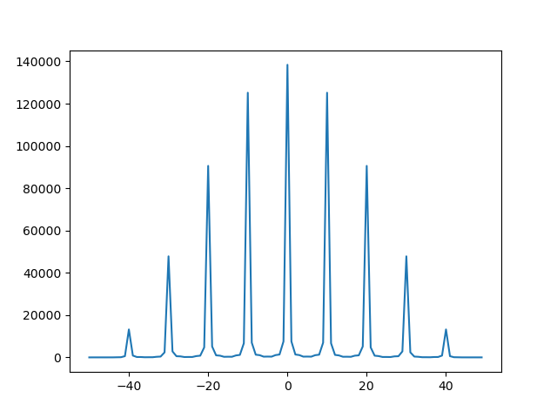
Step 3: Side-Lobe Analysis

Slide 7
Interpretation and Future Goals
Try more layouts (requires trial and error for now) and compare a large amount through analysis of side lobes.
Find ways to quickly generate layout plans with less effort (as opposed to manually inputting coordinates).
Present the most optimal, physically reasonable layout and use at Meteor Crater.

Slide 8
Acknowledgements
Desiree Crawl, Dr. Thomas Sharp
ASU/NASA Space Grant
LoCo Lab
School of Earth and Space Exploration

Slide 9
Thank You For Listening!
Questions?

